Slide 1
Data Driven Spirals
Pavan Poojar

Slide 2
16 shots Spiral trajectories with different alpha
Alpha=2
Alpha=3
Alpha=4
Alpha=5
Alpha=6
Alpha=7
Alpha=8
Alpha=9
Alpha=10

Slide 3
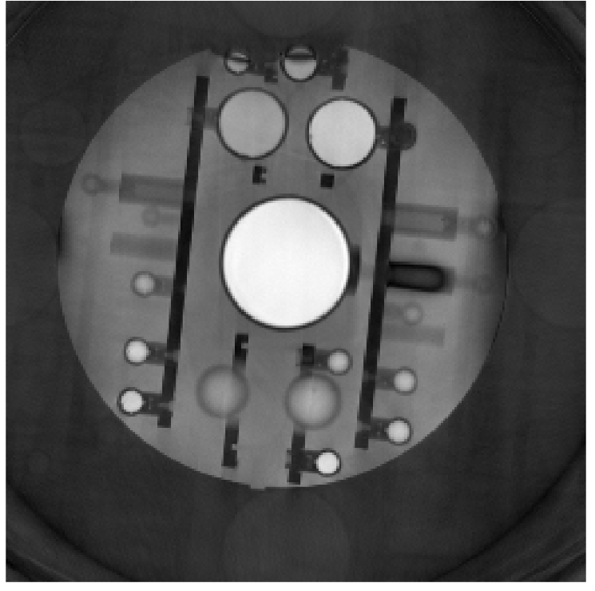
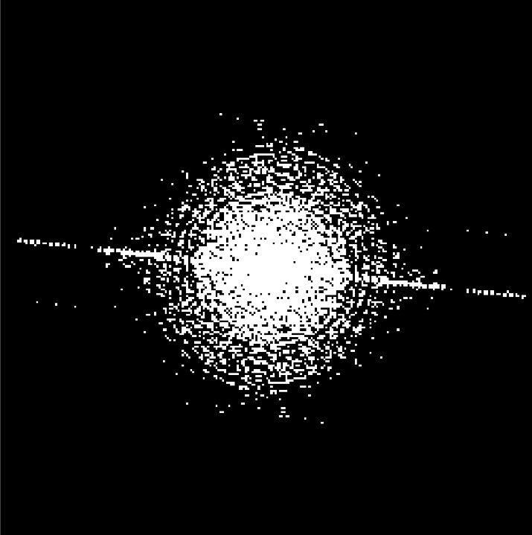
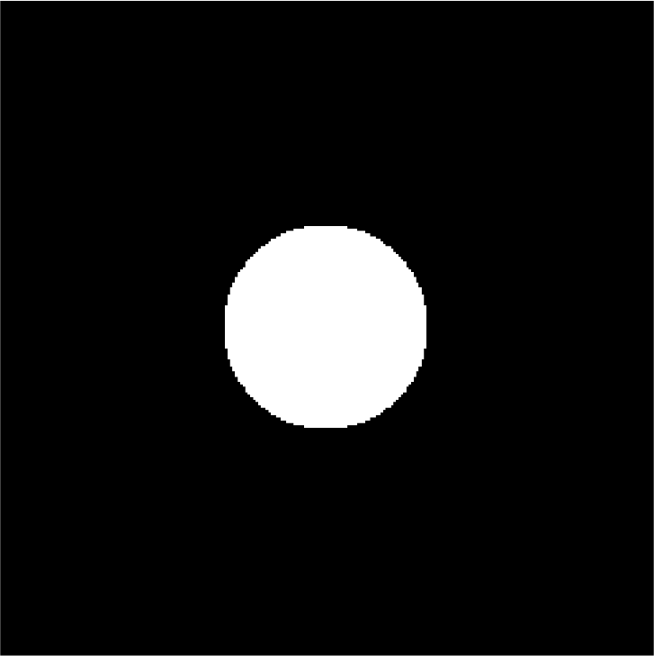
Selection of alpha value
a
b
c
Input image
K-space
K-space mask (mean+10*SD)
f
e
d
Overlay – d & e
Alpha = 3
Circular mask

Slide 4
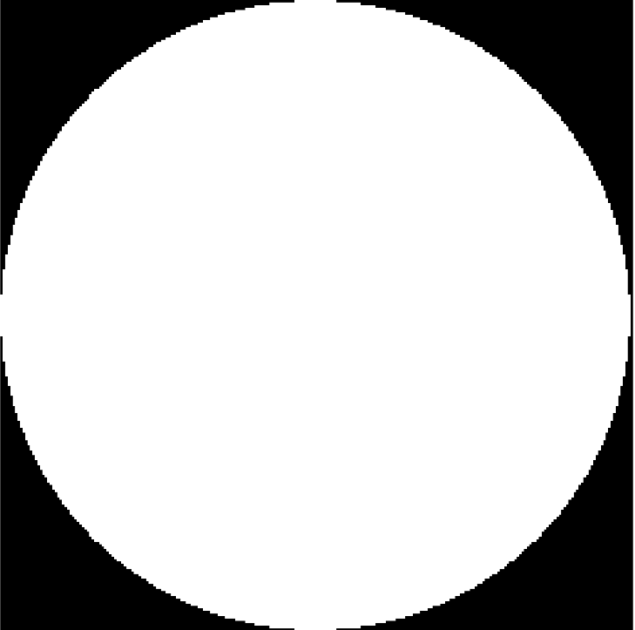
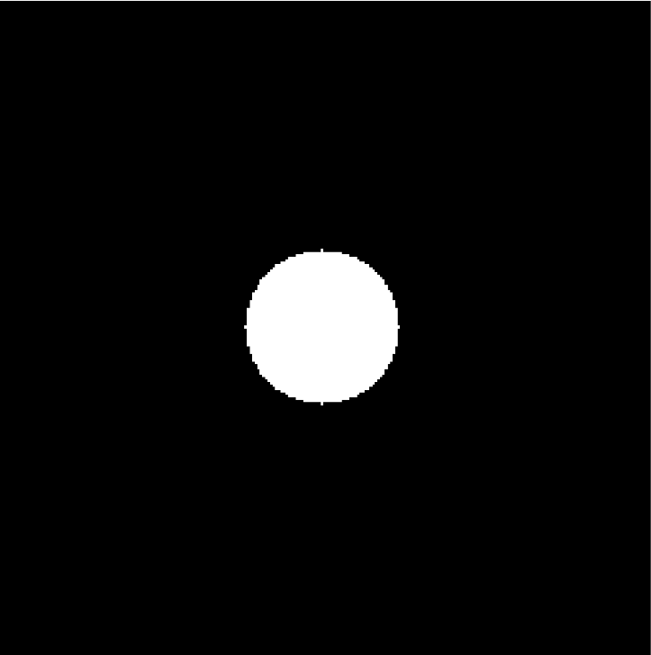
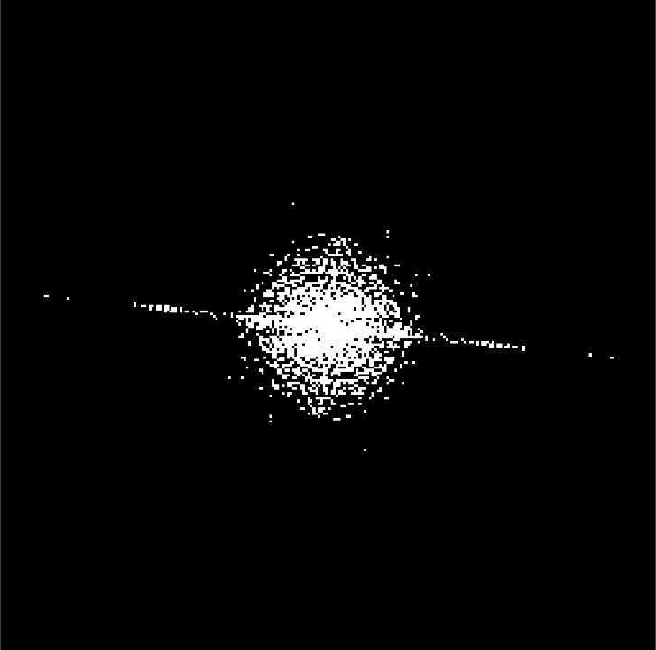
a
b
Input image
K-space
b.*c
Threshold mask
Trajectory + f
e+f
Mask to determine alpha (alpha=3)
Mean+sd of (d)

Slide 5
Alpha value | Number of shots | Number of points per shot | ADC (ms)
2 | 36 | SR violation | SR violation
2 | 48 | SR violation | SR violation
3 | 36 | 936 | 9.4
3 | 48 | 674 | 6.7
4 | 36 | 1026 | 10.3
4 | 48 | 734 | 7.3
6 | 36 | 1140 | 11.14
6 | 48 | 810 | 8.10
8 | 36 | 1206 | 12.1
8 | 48 | 856 | 8.6
10 | 36 | 1252 | 12.5
10 | 48 | 886 | 8.9

Slide 6
Pulse sequence diagram
Pulse Sequence diagram (16 TRs)
Pulse Sequence diagram (1 TR)

